Slide 1
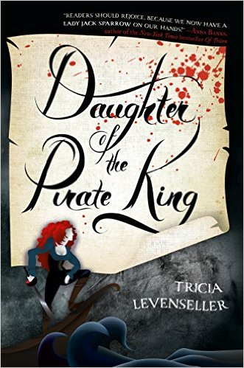
We’re LIVE
at the library but you can join us on ZOOM!
The Teen Advisory Board
@ Margaret E. Heggan Free Public Library presents:
Chapter Chat
Join us for a Teen Book Discussion Group!
Daughter of the
Pirate King
by Tricia Levenseller
Tuesday, May 31 at 5:30 PM
TAB Chapter Chat is a book club run by and for teens.
This reading group meets monthly to discuss popular YA Fiction.
Register online via the Event calendar under Programs.
The book is available at the library or as an audiobook on Hoopla.
Please call the library at 856-589-3334 for assistance.
Margaret E. Heggan Free Public Library
606 Delsea Drive, Sewell, NJ 08080 ● 856-589-3334 ● www.hegganlibrary.org

